Slide 1
Shiloh High School Class of 2019 Senior Letters

Slide 2
AGENDA
Graduation Requirements
Senior Letter
Testing Requirements

Slide 3
Counseling Office Staff
Beyonka Adams 9th Grade Academy
Dinaia Crumbley IB & Registration
Dr. Aisha Stephen Academy Specialist
Devin Jones STEM Academy (10th – 12th)
Dr. Sineca Muhammad BAM Academy (10th – 12th)
Dr. Daria Williamson WHE Academy (10th – 12th)

Slide 4
Senior Sponsors
D. Goodwin
H. Walsh
Senior Remind text 81010 and then input the code @shsrs2019

Slide 5
Gwinnett County School System Graduation Requirements
Area of Study | Required Credits
English/Language Arts | 4 credits
Mathematics | 4 credits
Science | 4 credits
Social Studies | 3 credits
CTAE/World Language/Fine Arts | 3 credits
P.E. / Health | 1 credits
Electives | 4 credits
TOTAL CREDITS: | 23 credits
Two years of the same foreign language are required for admissions into University System of Georgia colleges and universities
Three years of JROTC can be used to fulfill P.E./Health requirement

Slide 6
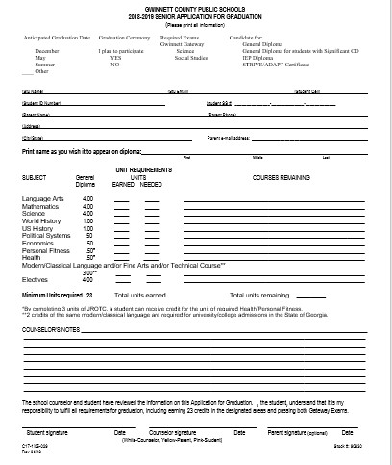

Slide 9
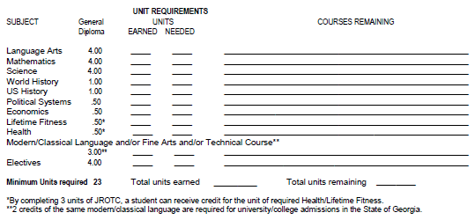

Slide 10
Do You Need to Make Up Classes?
Credit Recovery at Shiloh High School
$75 for 0.5 credit
Gwinnett Online Campus
$250 for 0.5 credit
Phoenix High School (Evening Classes)
$250 for 0.5 credit
Courses taken outside of GCPS
Must meet with counselor
Must complete School Plus Form
Final exam/EOC

Slide 11
Testing Requirements
EOC/ GA Milestone Courses
Math Algebra I or Geometry
Science Biology
Social Studies US History or Economics
Language Arts 9th Lit/Comp or American Lit
Gateway Exam
All student must pass the Social Studies and Science Gateway exam
Retest: Sept 18th and Sept 19th

Slide 12
AP TESTING
Students enrolled in AP Courses will take AP Exams in May 2019
Students who receive a 3 or higher on an AP Exam *may receive college credit for those courses
* Students must check with the University that they are interested in to find out whether they will accept high school AP Course credit.

Slide 13
Appointments
If you have questions for your student’s counselor please scan the QR code on the flyer to schedule an appointment

Slide 14
College Planning
Dr. Aisha Stephen

