Slide 1
Senior Core Curriculum
Class of 2019
Presented by :
SHS Counseling Department

Slide 2
SHS Counseling Staff
Mrs. Beyonka Adams 9th Grade Academy E105
Ms. Dinaia Crumbley IB & Registration E105
Mr. Devin Jones STEM (10th - 12th) WHE Academy Office
Dr. Sineca Muhammed BAM (10th - 12th) BAM Academy Office
Dr. Aisha Stephen Academy Specialist C29
Dr. Daria Williamson WHE (10th -12th) AME Academy Office
Ms. Ashley Bill 9th – 12th grade Counseling Intern

Slide 3
Objectives
Be aware of important faculty / staff who will assist you Senior Year.
Review Senior Application Letters
  (Credit Evaluation Status)
Identify steps to:
  Apply to college
  Apply for financial aid & scholarships
  Request Transcripts & Recommendations
  Request ACT/SAT Waivers
Return Senior Letters Signed to Your Counselor

Slide 4
PreTest
Who are your Senior Sponsors?
How many credits do you need for graduation?
Which tests are required for college admission?
What form must be filled out to receive financial aid?
    When?
Where can you find scholarship information?
How do you request SAT/ACT waivers?
How can you request transcripts?
    Georgia?
    Out of State?

Slide 5
SENIOR SPONSORS
Senior Sponsors:
D. Goodwin
H.Walsh

Slide 6
Gwinnett County School System
Graduation Requirements
Area of Study | Required Credits
English/Language Arts | 4 credits
Mathematics | 4 credits
Science | 4 credits
Social Studies | 3 credits
CTAE/World Language/Fine Arts | 3 credits
P.E. / Health | 1 credits
Electives | 4 credits
TOTAL CREDITS: | 23 credits
Two years of the same foreign language are required for admissions into University System of Georgia colleges and universities
Three years of JROTC can be used to fulfill P.E./Health Requirement

Slide 7
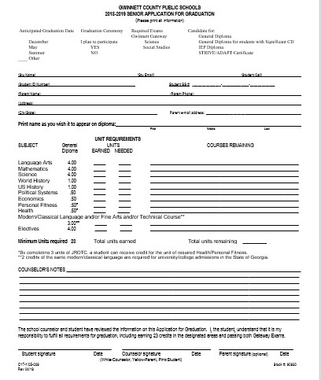

Slide 8


Slide 9
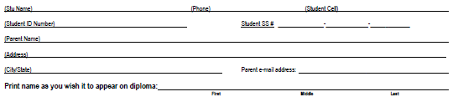

Slide 10
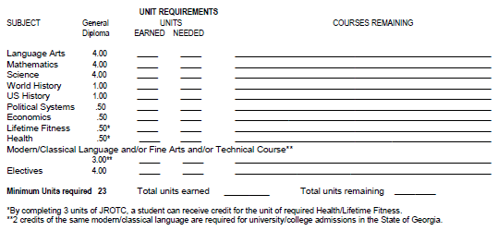

Slide 11
Do You Need to Make Up Classes?
Credit Recovery at Shiloh High
$75 for 0.5 credit
Gwinnett Online Campus
$250 for 0.5 credit
Phoenix High School (Evening Classes)
$250 for 0.5 credit

Slide 12
Do You Need to Make Up Classes?
TAKING COURSES OUTSIDE OF GCPS
As of August 6, 2018:
Students who are enrolled in Gwinnett County Public Schools and seeking credit from a private school must take and pass EOC (End of Course) Assessments regardless of the private school’s accreditation status.
The GCPS Office of School Improvement and Operations must approve all credit awarded for course work completed at another institution while concurrently enrolled in a GCPS school.
Students MUST meet with their counselor prior to registering for ANY class outside of Gwinnett County Public Schools
Students and parents must sign a School Plus Form (Academy counselor))

Slide 13

Testing Requirements
End of Course (EOC) / GA Milestones:
Math Algebra I or Geometry
Science Biology
Social Studies US History or Economics
Language Arts 9th Lit/Comp or American Lit
Gateway Exam
- All students must pass the S. Studies and Science Gateway exam

Slide 14
AP TESTING
Students enrolled in AP Courses will take AP Exams in May 2019
Students who receive a 3 or higher on an AP Exam *may receive college credit for those courses
* Students must check with the College or University that they are interested in to find out whether they will accept high school AP Course credit.

Slide 15
Options After High School
4-year College/University
2-year College
Technical College
Military
Work

Slide 16
Where Should I Apply to College?
Factors to consider:
Size, Costs, Location, Major, Environment, Admission Requirements
Apply to more than one schools
    Dream School - may not get in, but is your top choice
    Target School - have a good chance of being admitted
    Safety School - back up plan
Attend a College Fair and Probe Fair
Visit the college you plan on applying to
Listen to the announcements for recruiters coming to Shiloh High

Slide 17

How Do I Apply for College?
Common Application
commonapp.org
Common Black College Application
commonblackcollegeapp.com
GA Futures
gafutures.org
College/University Website

Slide 18
GA Futures
Apply to Georgia colleges, universities, and technical colleges
View preliminary HOPE G.P.A.
Financial aid information
Send transcripts

Slide 19
How Do I Apply for College?
Test Scores
Official scores must come from ACT or College Board
Letters of Recommendation
Complete senior profile (found on the SHS Counseling Dept website)
Transcripts
In State - Send your transcript through GAFUTURES for free
Out of State - Pay $5 to request an official transcript from your academy office (available for pickup in two business days).
It is your responsibility to meet ALL deadlines!

Slide 20
Campus Visits
All schools look appealing from their catalogs and view books.
Visit and feel the school out…you will be there for four years.
Pick up a Pre-Arranged absence form.

Slide 21

Need a Recommendation??
  Complete Student Profile Sheet
    Found on the counseling website
  You may need one from a teacher
  You may need one from a counselor
  Give us TIME
  At Least 10 School Days

Slide 22
College Entrance Exams
*Which Test Should I Take?*
We encourage students to take both the ACT and SAT

Slide 23
College Entrance Exams
SAT
Given 7 times each school year
Includes Critical Reasoning, Math, and a Writing section
Each section is worth 200-800 points for a maximum of 1600 points.
1600 is the highest possible score
Test Fee
  $45 no essay
  $57 with essay
Website:
http://sat.collegeboard.org/register

Slide 24
College Entrance Exams
ACT
Given 6 times each school year
Includes English, Math, Reading, and Science Reasoning. Writing/Essay is optional but required by most schools
Can receive a score of 1-36 for each subject, averaged for a composite score. 36 is the highest possible composite score
Achievement test – measures what a student has learned in school
Scored based on correct answers - no penalty for guessing
Test Fee:
$42.50 ACT
$58.50 ACT plus writing
Website:
www.actstudent.org

Slide 25
Other College Entrance Exams & Military Exam
SAT Subject Tests
Specific subject area tests
Not required by all schools
Can be used for placement or to exempt courses at some colleges and universities
Accuplacer
An untimed, computerized test that helps your college evaluate your skills and place you in appropriate courses
ASVAB
Test used for military entrance
Talk to your recruiter to determine the score needed for the branch of the military that you are interested in

Slide 26
Paying for College
FAFSA
Scholarships
HOPE scholarship
Zell Miller Scholarship

Slide 27
FAFSA
Free Application for Federal Student Aid
Can be completed online
Apply for your pin number at www.pin.ed.gov
Students may begin filling out for FAFSA starting October 1, 2018 using 2017 tax information
Website: www.fafsa.ed.gov

Slide 28
Scholarships
Check Shiloh High School Counseling Department page
    GATES Scholarship
    QuestBridge
Websites such as fastweb.com and gafutures.org
Your local church, community center, parents’ jobs

Slide 29
HOPE Scholarship
Must graduate with a minimum of 3.0 core GPA.
- HOPE GPA is different from your cumulative GPA that is on your GCPS transcript
HOPE GPA can be calculated on GA Futures
- We must have your social security number on file at Shiloh High
- If a copy is not on file with Shiloh High, you MUST bring a copy of your social security card to the counseling office by November 9, 2018
Award amounts vary depending on the institution (visit GA Futures for an award amount chart and additional info about the HOPE scholarship).

Slide 30
Zell Miller Scholarship
3.7 core GPA
Receive a minimum of 1200 combined critical reading and math on a single administration of the SAT or receive a composite score of 26 on a single administration of the ACT

Slide 31
Reminders
Be aware of application deadlines
Begin looking for scholarships
Apply to more than one school:
Request recommendations in advance on the counseling department website (recommendations will be completed in 10 business days).
DO NOT request an appointment if you need an SAT/ACT Waiver, application fee waiver, or transcript request
DO NOT pay to send transcripts to GA Colleges!!! Use GA Futures
Visit the Shiloh High School website for updates
Don’t forget to join the Shiloh High School PTSA!
Senior year is very important. Do not slack off in your classes or allow your grades to drop. If you need assistance in any of your classes, seek help from your teachers early and attend tutorial!

Slide 32
Important Dates to Remember
Gates Scholarship
  September 18th
Quest Bridge
  September 27th
PROBE Fairs
  Gwinnett South – October 2nd at Shiloh HS
UGA Early Action
  October 15th
College Week
  November 12th - 16th

Slide 33


QUESTIONS

Slide 34
Congratulations
Class of 2019

