Slide 1
Junior Core Curriculum Presentation

Slide 2
Your Counseling Department
Mrs. Adams (9th Grade academy)
Ms. Crumbley (IB academy)
Mr. Jones (STEM academy)
Dr. Muhammad (BAM academy)
Dr. Stephen (Academy Specialist)
Dr. Williamson (WHE academy)
Updates found on
http://shilohhighcounselors.weebly.com/
Notes:
Ms. Robinson handles transcripts, appointments, etc
Use them as a resource!!! They are here for YOU!

Slide 3
On the Agenda…
Promotion/Graduation Requirements
Recovery Options
Testing
Maxwell/Grayson Tech
HOPE Scholarship Program
Monthly to dos
College Selections

Slide 4
Promotion Requirements
5 credits 10th grade
11 credits 11th grade
17 credits 12th grade

Slide 5
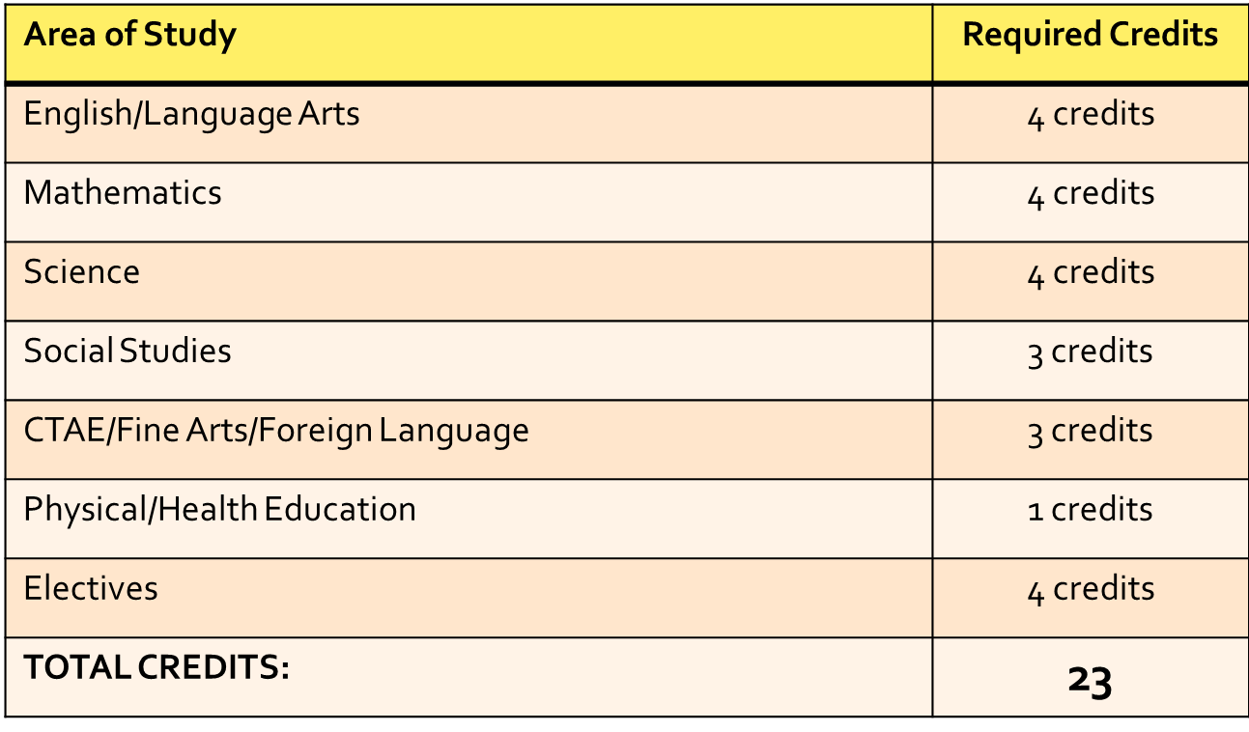
GRADUATION REQUIREMENTS
4 LA
4 Math
4 Science
1 Health/PE
3 Social Science
3 Fine Art/Technology/Foreign Language
4 Electives
____________________________
23 credits

Slide 6
Testing
Gateway – must pass in order to receive a GCPS diploma
Science and Social Studies
EOC Milestone counts for 20% of class grade.
10th Grade
Geometry, Physical Science
11th Grade
American Literature, US History

Slide 7
RECOVERY OPTIONS
Credit Recovery
Phoenix
Summer School
Gwinnett Online

Slide 8
SAT vs. ACT
Type of test
What it covers
Types of questions
Aptitude-Reasoning
Critical Reading, Math, Writing
Multiple Choice, Essay, Sentence Completion
Range of scores
200-800 on each section
National Average
about 1500
What it covers
Types of questions
Curriculum
English, Math, Science, Reading, Writing (optional)
Multiple Choice, Essay
Range of scores
1-36 on each section
National Average
21 or 22
Type of test
http://www.mytutor.com/sites/default/files/imce/SATACTChart.pdf

Slide 9
Official SAT Practice through Khan Academy
Practice tests and more
4 official full-length practice tests, plus study and test-taking tips
Short quizzes
8 diagnostic quizzes to pinpoint your areas for practice
Interactive practice
thousands of practice questions, video lessons, and hints
Instant feedback
constant feedback and progress so you know where you stand
www.khanacademy.org

Slide 10
CAREER ACADEMIES
Wellness, Health, and Education
Business, Arts and Marketing
Science, Technology, Engineering, and Math

Slide 11
Maxwell/Grayson Tech
Programs that allow students to get training in a particular area of interest
Student goes to Maxwell/Grayson for half of the day.
Student must have room in his/her schedule!
Websites:
www.maxwelhigh.com
www.graysontech.org

Slide 12
Maxwell/Grayson Tech
Grayson Tech
No transportation is provided!
Maxwell
Transportation is provided!
Architectural Drawing & Design
Collision Repair
Construction
Culinary Arts
Early Childhood Education
Electronics
Fire and Emergency Services (Firefighting)
Flight Operations
Graphic Design
HVACR
Interiors, Fashion, & Textiles
Law Enforcement Services
Maintenance & Light Repair (Auto Services)
Metals (Welding)
Personal Care Services (Cosmetology)
Audio Engineering
Commercial Photography
Culinary Arts
Digital Media
IT & Network Systems
Law & Justice
Music Technology
Robotics Engineering
Sports Medicine
TV & Video Production
Veterinary Science

Slide 13
HOPE Scholarship
Zell Miller Scholarship
3.7 GPA (Calculated by GSFC)
Full tuition covered (15 credit hours)
Rigor requirements
1200 SAT combined Reading + Math; 26 ACT composite score
HOPE Scholarship
3.0 GPA (calculated by GSFC)
80-90% tuition covered
Rigor Requirements
HOPE & Zell Miller Grant- for Technical Schools
No initial GPA requirement
A portion of the tuition covered
Must maintain 2.0 GPA after admission (3.5 for Zell Grant)
Notes:
**Pass out “Want HOPE” brochure

Slide 14
HOPE Rigor Requirements
In addition to GPA requirements, students must have 3 or 4 of these…
AP core courses
Dual Enrollment core courses
IB core courses
Chemistry, Anatomy, Physics
Second year or more of foreign language
GPS Pre-Calculus, Calculus, AMDM

Slide 15
April - Junior Year
Register to take the next administration of the SAT and/or ACT.
Create a résumé that accurately displays your accomplishments.
Register for Summer School, if necessary.
Complete the Move On When Ready (MOWR) application if interested.
Visit as many schools as possible.
Create a GA Futures account.

Slide 16
May - Junior Year
Register to take an SAT and/or ACT preparation course.
Complete and submit your Senior profile to your School Counselor.

Slide 17
June/July - Junior Year
Take the SAT and/or ACT course for which you have registered.
Continue visiting colleges.
Research scholarships and secure those applications.
Most submission deadlines are in October.
Participate in community service activities to add to your profile.

Slide 18
Questions?
Notes:
**Time capsule slips**

Slide 19
Georgia Career Information Systems
Go to http://www.gcic.peachnet.edu/
Click on the icon on the left side on the page that says
“CLICK HERE TO ENTER GEORGIA CAREER INFORMATION CENTER”
Username: Student Number
Password: Bdmmddyyyy ex: March 18, 2001 Bd03182001
Click on the Education Tab
Click Where Can I Study
Search for the schools that you are interested in:
Go to Georgia Schools
or
Go to US Schools
SAVE 3 SCHOOLS THAT YOU ARE INTERESTED IN ATTENDING

